Slide 1
Search for accommodation in Madrid
Capstone Project (by César Portales)

Slide 2
Introduction
Madrid Familiar Tours (MFT) is a company dedicated to organizing guided tours of the main monuments of Madrid and its surroundings. Visits last (depending on the package you hire) of between three and five days. Request that we make it easier to find accommodation that meets the following requirements:
Maximum distance of 1.5 kms. To the Prado Museum
Accommodations must be of the whole apartment type Information on Price, Kitchen, Kids Friendly, Smoking, Pets, Internet Access, Welchair Accessibility,
Information about points of interest near the accommodation

Slide 3
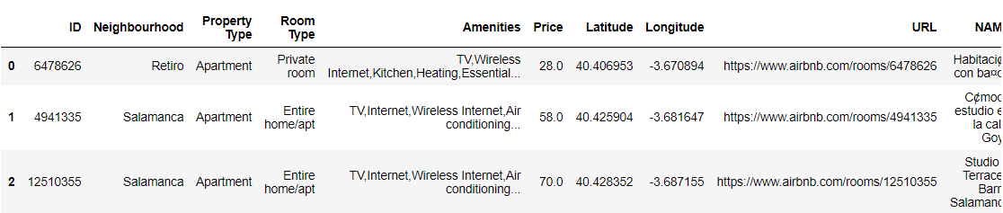
Data Sources
For this purpose, we will use:
A public Airbnb file in csv format (airbnb-extract-Madrid.csv), which contains information about accommodation in Madrid.
The Dataset contains the following fields: Property ID, Neighborhood, Property Type, Room Type, Amenities, Latitude, Longitude, Property URL, and Property Name.
As far as points of interest near the accommodation are concerned, we will need to use the Foursquare location data.

Slide 4
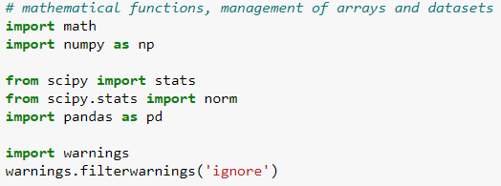
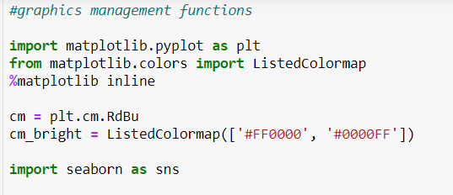
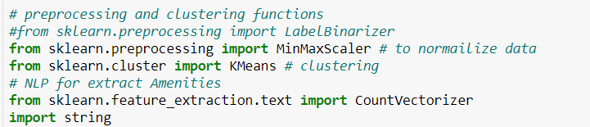
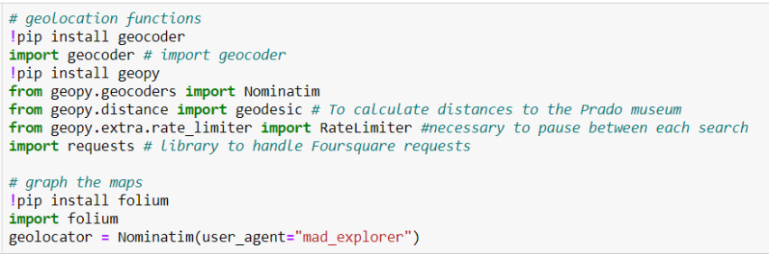
Methodology
We'll use jupyter notebooks and the programming language will be Python

Slide 5
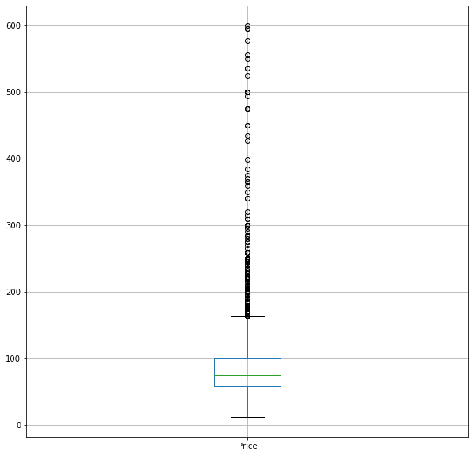
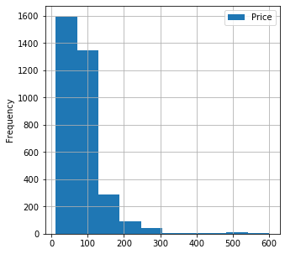
Data cleaning I
The price data has too many outliers. It is decided to work only with accommodation priced less than 250 euros

Slide 6
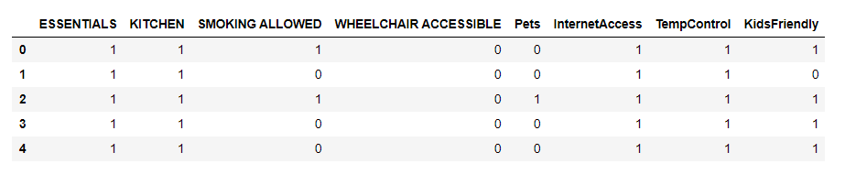
Data Cleaning II
Using NLP techniques, you get the necessary information from the Amenities field

Slide 7
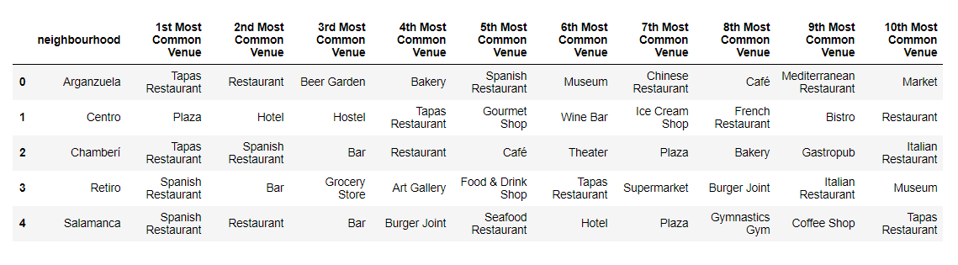
Neighborhood exploration
The Foursquare API is used to get information about the main points of interest within 500 meters of each neighborhood

Slide 8
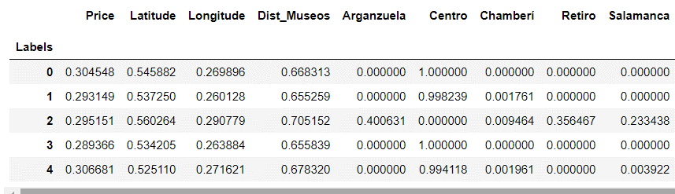
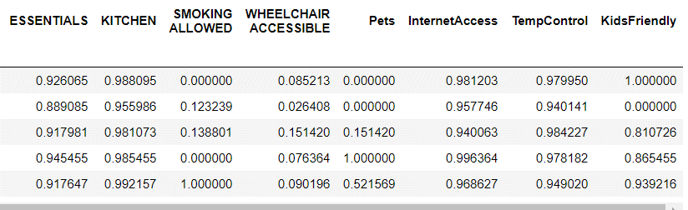
Clustering
The classification carried out would allow us to select by the following groups:
Cluster 1: In Centro Ward (or very close), pets are allowed, smoking is not allowed, and very high probability of being Kids Friendly
Cluster 2: In Centro Ward, pets are not allowed, smoking is not allowed, and not kids friendly
Cluster 3: In Centro Ward, pets are not allowed, smoking is not allowed, and kids friendly
Cluster 4: Not In Centro Ward, pets are not allowed, smoking is not allowed, and very probably kids friendly

Slide 9
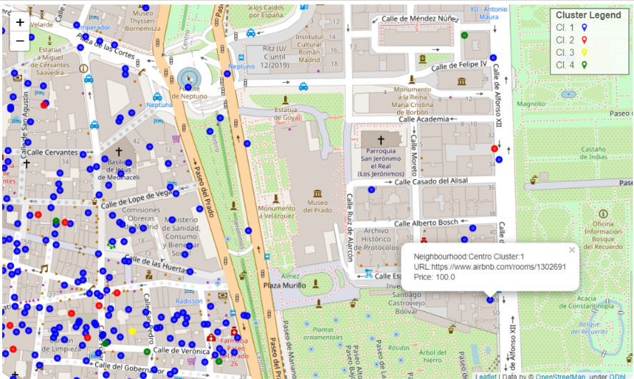
Accommodation distribution map

Slide 10
Conclusions and future directions
The offer of tourist accommodation provided is of great interest, having the vast majority of essentials accommodations, kitchen, internet access at a reasonable price and with a lot of close supply when it comes to food.
Iit would be recommended to improve the wheelchair access part. It is clear that in the downtown area (with the oldest houses in Madrid) it was going to be difficult to meet this requirement (it is not therefore a problem of the dataset that has been used).
If you want to satisfy this type of tourism, it would be advisable to contact companies transporting specialized travelers, since accommodations with wheelchair access are far from the points where you are going to work.

